Slide 1



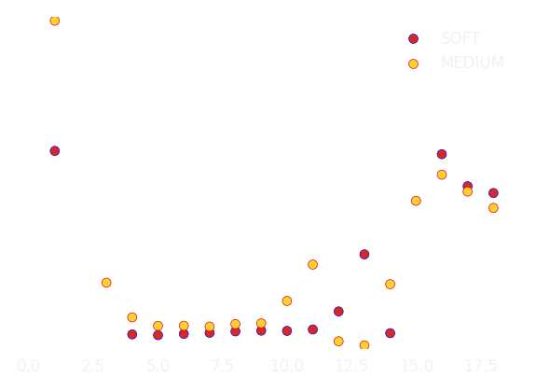
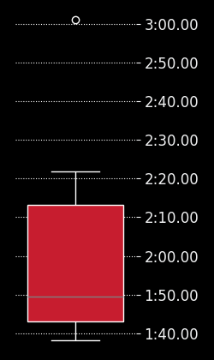
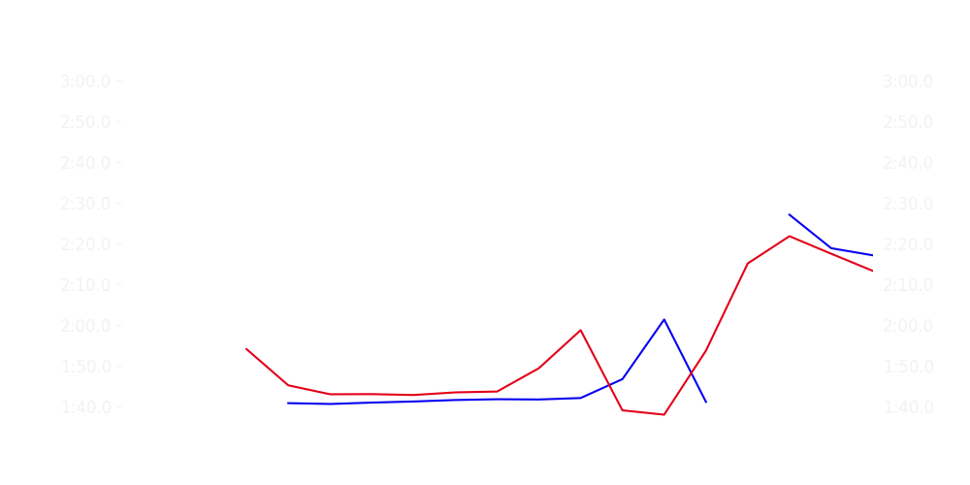
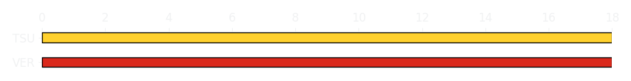
Miami GP Sprint Race
Driver
Race Time
Race Time
Driver
Max Verstappen
0:26:53.706
0:28:28.401
Yuki Tsunoda
Avg Lap Time
1:41.798
IQR
Gap
Gap
IQR
Avg Lap Time
5.563 s
-3.121 s
+3.121 s
10.945 s
1:44.500
Race Comparaison
Race Comparaison
Lap Advantage
9/16
Position
4
Safety Car Lap
5/16
Position
10
Lap Advantage
2/16
Lap Time Per Lap
Lap Time Per Lap
Tyre Strategy
Total Pit Stop Time
0:00:00
Pit Stops
0
Pit Stops
0
Total Pit Stop Time
0:00:00
Tyre Strategy

Slide 2

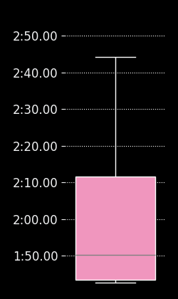
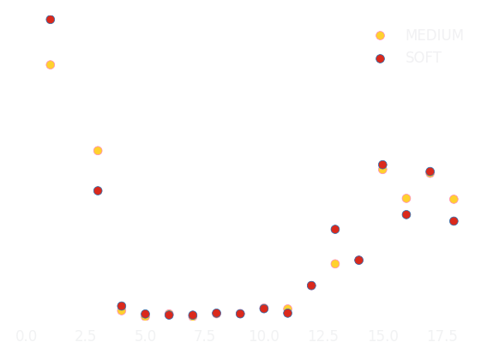

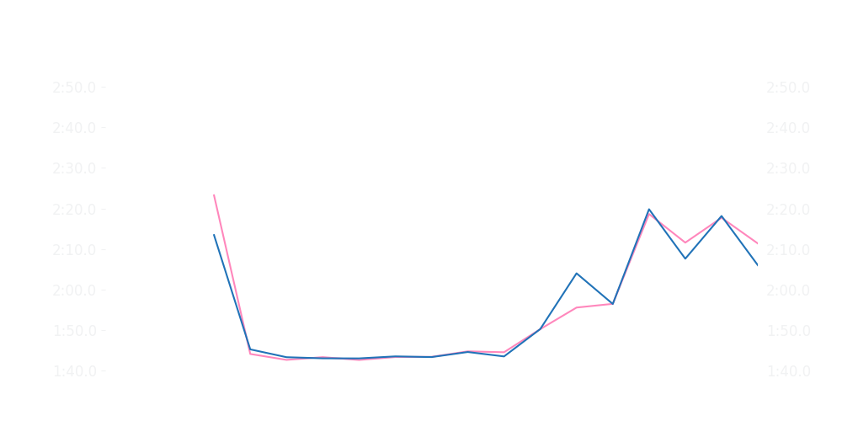
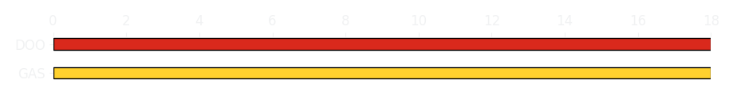
Miami GP Sprint Race
Driver
Race Time
Race Time
Driver
Pierre Gasly
0:28:31.010
0:28:32.534
Jack Doohan
Avg Lap Time
1:47.550
IQR
Gap
Gap
IQR
Avg Lap Time
27.995 s
-3.936 s
+3.936 s
22.916 s
1:47.808
Race Comparaison
Race Comparaison
Lap Advantage
7/17
Position
12
Safety Car Lap
5/17
Position
17
Lap Advantage
5/17
Lap Time Per Lap
Lap Time Per Lap
Tyre Strategy
Total Pit Stop Time
0:00:00
Pit Stops
0
Pit Stops
0
Total Pit Stop Time
0:00:00
Tyre Strategy

Slide 3

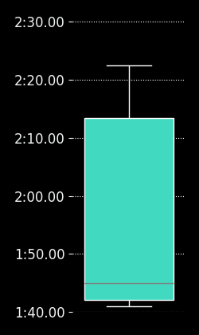
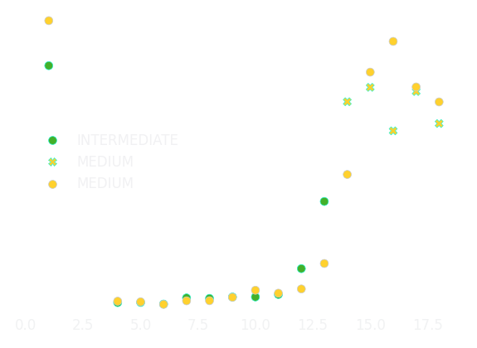

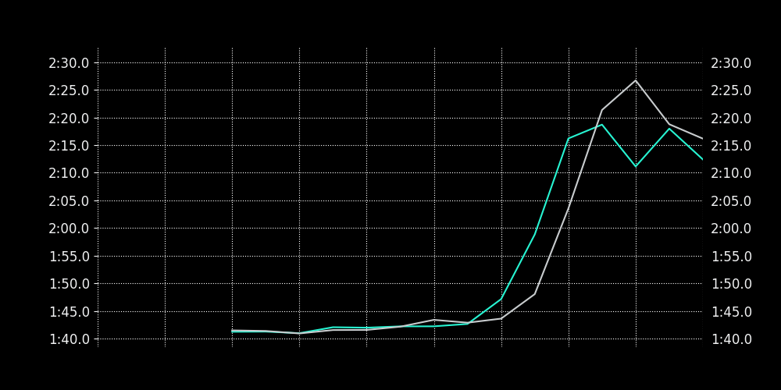
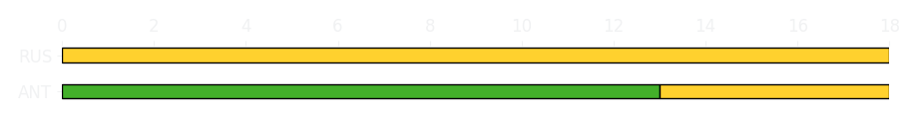
Miami GP Sprint Race
Driver
Race Time
Race Time
Driver
Kimi Antonelli
0:26:56.009
0:26:52.294
George Russell
Avg Lap Time
1:42.681
IQR
Gap
Gap
IQR
Avg Lap Time
29.721 s
+02.467 s
-02.467 s
18.098 s
1:43.165
Race Comparaison
Race Comparaison
Lap Advantage
5/16
Position
11
Safety Car Lap
5/16
Position
6
Lap Advantage
6/16
Lap Time Per Lap
Lap Time Per Lap
Tyre Strategy
Total Pit Stop Time
0:00:00
Pit Stops
0
Pit Stops
0
Total Pit Stop Time
0:00:00
Tyre Strategy

Slide 4


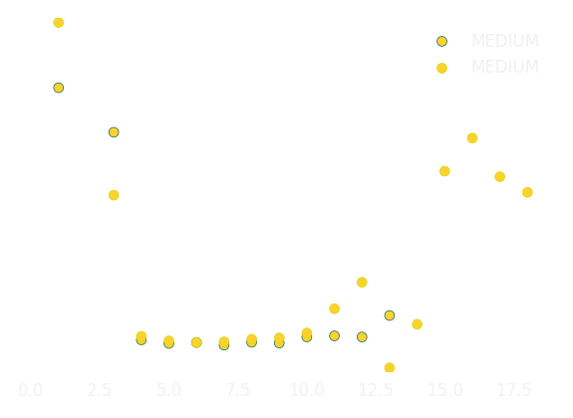
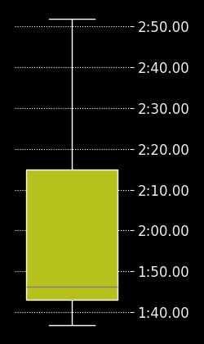
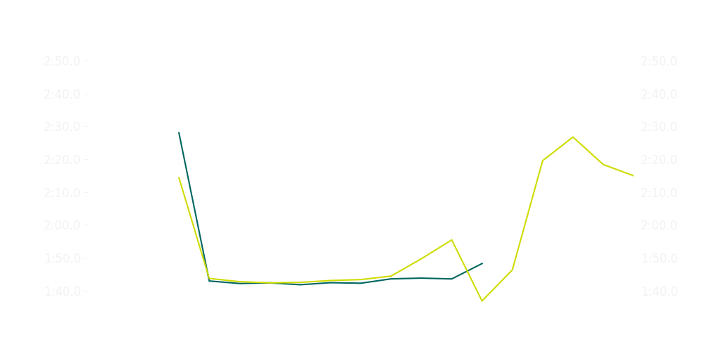
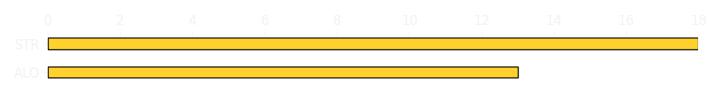
Miami GP Sprint Race
Driver
Race Time
Race Time
Driver
Fernando Alonso
0:15:30.042
0:28:29.900
Lance Stroll
Avg Lap Time
1:42.657
IQR
Gap
Gap
IQR
Avg Lap Time
1.288 s
+5 laps
-5 laps
6.989 s
1:43.696
Race Comparaison
Race Comparaison
Lap Advantage
10/17
Position
4
Safety Car Lap
5/17
Position
7
Lap Advantage
2/17
Lap Time Per Lap
Lap Time Per Lap
Tyre Strategy
Total Pit Stop Time
0:00:00
Pit Stops
0
Pit Stops
0
Total Pit Stop Time
0:00:00
Tyre Strategy

Slide 5

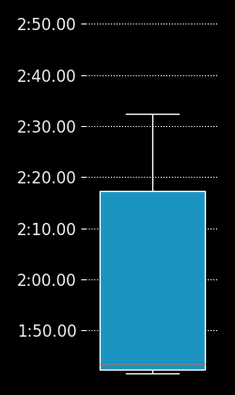
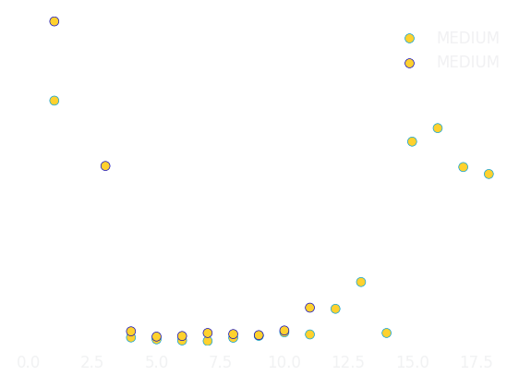

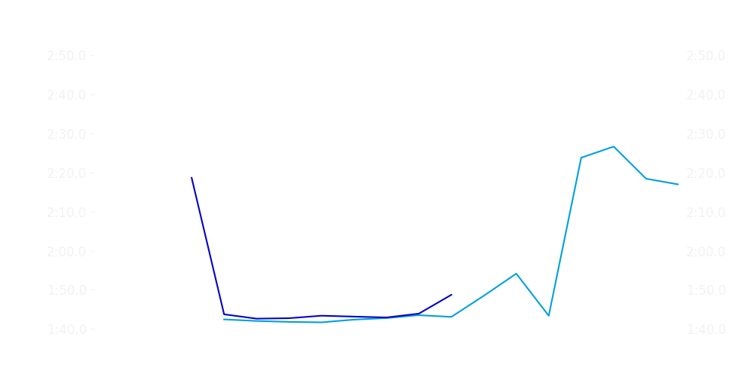
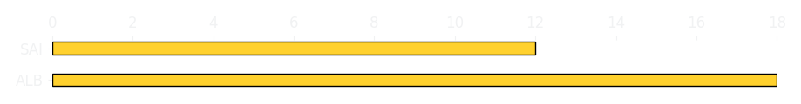
Miami GP Sprint Race
Driver
Race Time
Race Time
Driver
Charles Leclerc
0
0:17:14.952
Lewis Hamilton
Avg Lap Time
0
IQR
Gap
Gap
IQR
Avg Lap Time
0
+18 laps
-18 laps
1.377 s
1:42.121
Race Comparaison
Race Comparaison
Lap Advantage
0/18
Position
DNF
Safety Car Lap
5/18
Position
3
Lap Advantage
13/18
Lap Time Per Lap
Lap Time Per Lap
Tyre Strategy
Total Pit Stop Time
0:00:00
Pit Stops
0
Pit Stops
0
Total Pit Stop Time
0:00:00
Tyre Strategy

Slide 6

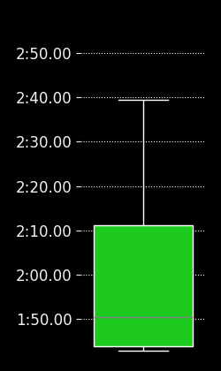
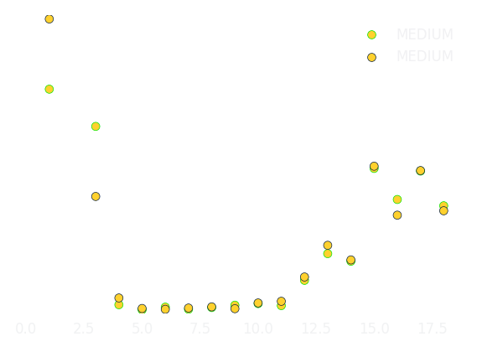

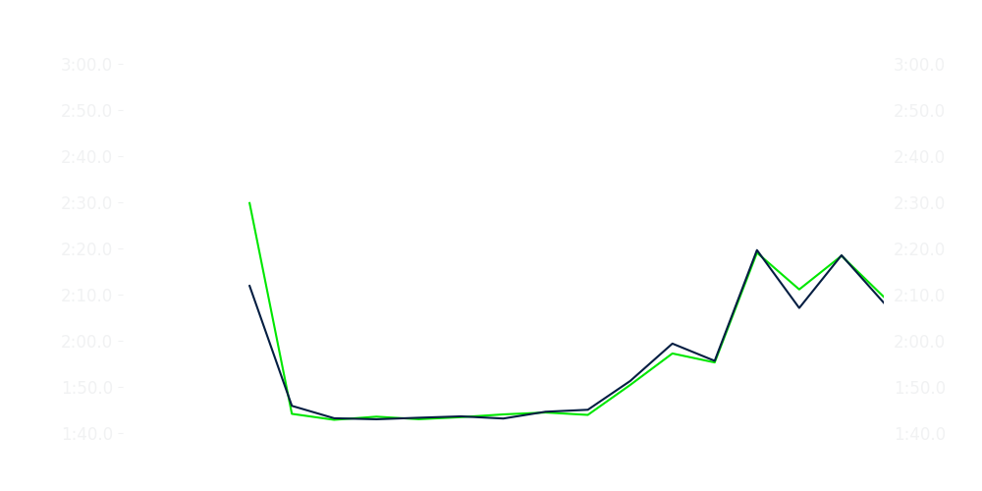
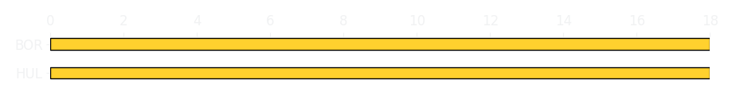
Miami GP Sprint Race
Driver
Race Time
Race Time
Driver
Alexander Albon
0:26:49.293
0:13:51.317
Carlos Sainz
Avg Lap Time
1:43.090
IQR
Gap
Gap
IQR
Avg Lap Time
6.11 s
-6 laps
+6 laps
0.981 s
1:43.395
Race Comparaison
Race Comparaison
Lap Advantage
10/15
Position
5
Safety Car Lap
5/15
Position
16
Lap Advantage
0/15
Lap Time Per Lap
Lap Time Per Lap
Tyre Strategy
Total Pit Stop Time
0:00:00
Pit Stops
0
Pit Stops
0
Total Pit Stop Time
0:00:00
Tyre Strategy

Slide 7

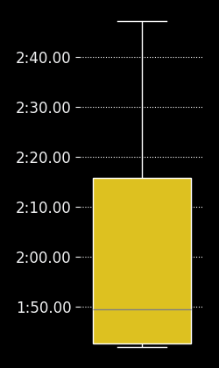
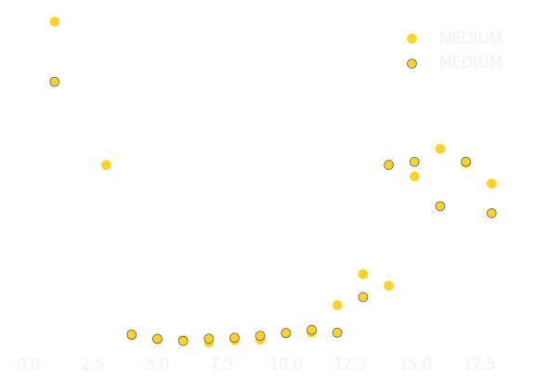

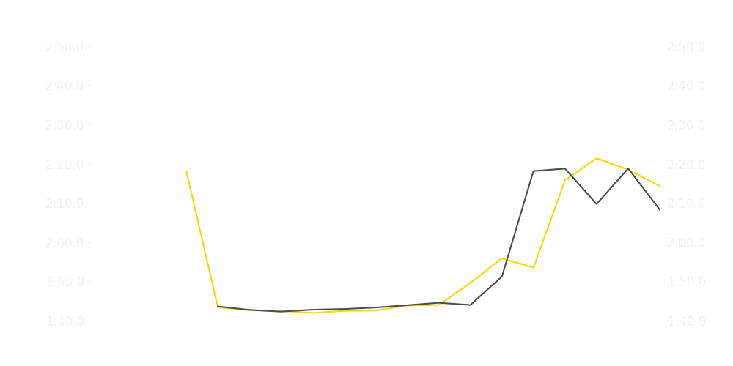

Miami GP Sprint Race
Driver
Race Time
Race Time
Driver
Nico Hulkenberg
0:26:46.409
0:28:31.685
Gabriel Bortoleto
Avg Lap Time
1:44.455
IQR
Gap
Gap
IQR
Avg Lap Time
19.638 s
-3.5220000000000002 s
+3.5220000000000002 s
23.848 s
1:48.585
Race Comparaison
Race Comparaison
Lap Advantage
9/17
Position
13
Safety Car Lap
5/17
Position
16
Lap Advantage
3/17
Lap Time Per Lap
Lap Time Per Lap
Tyre Strategy
Total Pit Stop Time
0:00:00
Pit Stops
0
Pit Stops
0
Total Pit Stop Time
0:00:00
Tyre Strategy

Slide 8


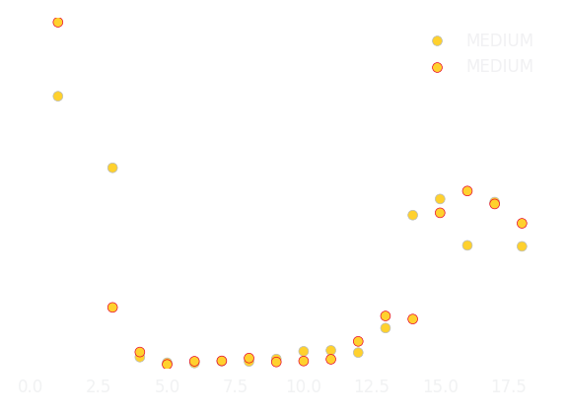
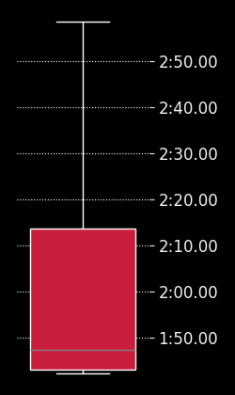
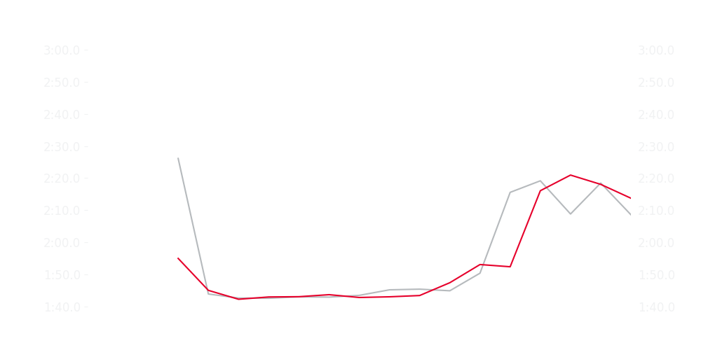

Miami GP Sprint Race
Driver
Race Time
Race Time
Driver
Liam Lawson
0:28:31.887
0:26:51.006
Isack Hadjar
Avg Lap Time
1:46.766
IQR
Gap
Gap
IQR
Avg Lap Time
32.079 s
-3.376 s
+3.376 s
25.863 s
1:43.952
Race Comparaison
Race Comparaison
Lap Advantage
7/16
Position
8
Safety Car Lap
5/16
Position
14
Lap Advantage
4/16
Lap Time Per Lap
Lap Time Per Lap
Tyre Strategy
Total Pit Stop Time
0:00:00
Pit Stops
0
Pit Stops
0
Total Pit Stop Time
0:00:00
Tyre Strategy

Slide 9

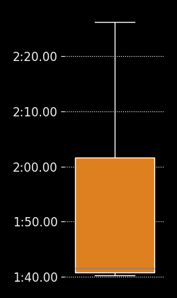
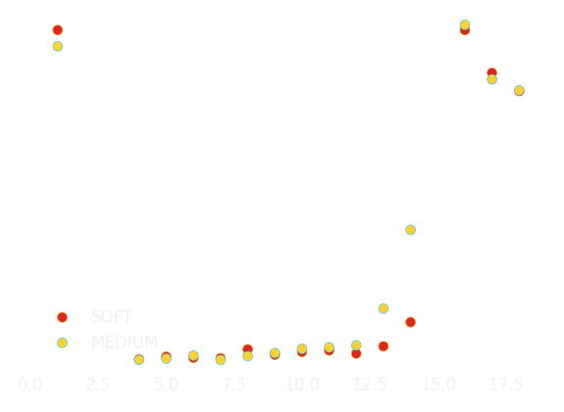
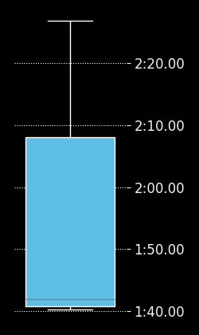
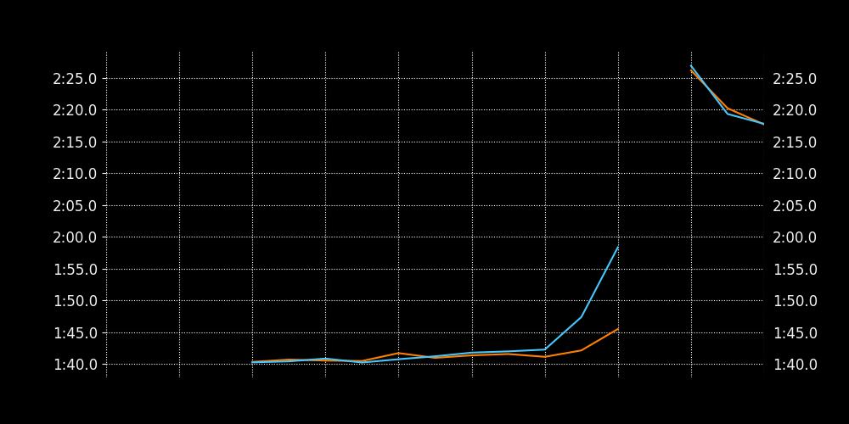
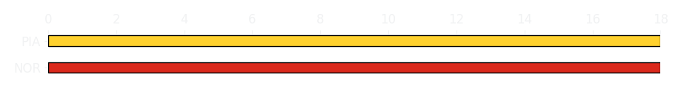
Miami GP Sprint Race
Driver
Race Time
Race Time
Driver
Esteban Ocon
0:26:50.851
0:28:27.656
Ollie Bearman
Avg Lap Time
1:45.173
IQR
Gap
Gap
IQR
Avg Lap Time
25.48 s
+04.780 s
-04.780 s
16.63 s
1:46.199
Race Comparaison
Race Comparaison
Lap Advantage
7/17
Position
15
Safety Car Lap
5/17
Position
9
Lap Advantage
5/17
Lap Time Per Lap
Lap Time Per Lap
Tyre Strategy
Total Pit Stop Time
0:00:00
Pit Stops
0
Pit Stops
0
Total Pit Stop Time
0:00:00
Tyre Strategy

